Slide 1




Amazon ML Challenge Finale Test Data
Kanahia
Anubhav Chandak
Animesh Tripathy
Kaustubh Kumar
Indian Institute of Technology, IIT Patna
Indian Institute of Technology, IIT Patna
Indian Institute of Technology, IIT Patna
Indian Institute of Technology, IIT Patna

Slide 2
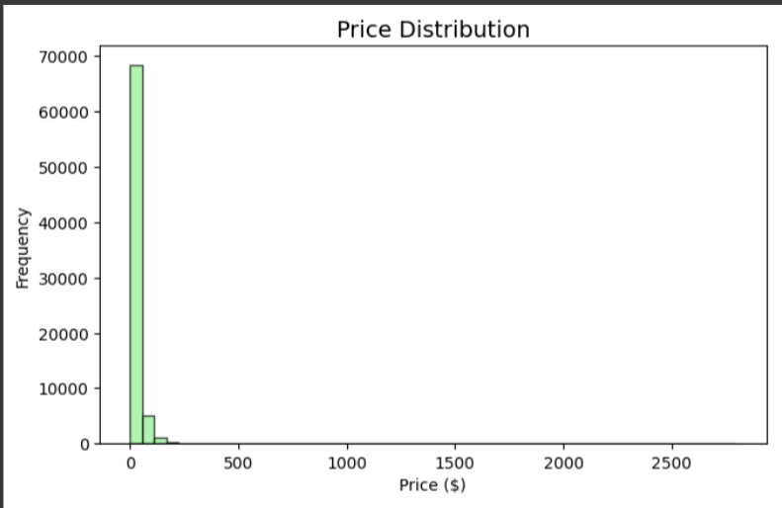
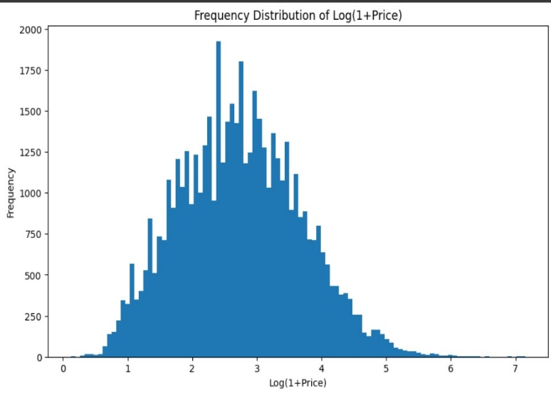
EDA and Data Pre- Processing
Handling Duplicates
Price Distribution
Training Set Rows - 75000
Unique Catalog_Content - 74900
Unique Image_Link - 72288
Duplicate Summary: Rows with Duplicate Content - 193 (0.3%)
Rows with Duplicate Images - 4887 (6.5%)
Rows with Exact Duplicate - 92 (0.1%)
Min Price | 0.13
Max Price | 2796.00
Mean Price | 23.64
Standard Deviation | 33.37
Skewness | 13.60
Kurtosis | 736.66
Rows with Duplicate Content – No changes made to Price
Rows with Duplicate Image – Average of Price taken for all
Rows with Exact Duplicate – Average of Price taken and all except single pair dropped

Slide 3
Model Evolution & Rationale
Sentence Transformers(Text Embedding) + XGBoost (M1)
Text-Only Baseline
EfficientNet-B4 + BERT-base with Attention (M2)
Model Evolution
Custom Dual Encoder
Fine-Tuned OpenAI CLIP-ViT-L/14 with Regression Head (M3)
Vision Language
Model (VLM)
Fine-Tuned LAION CLIP-ViT-H/14 with Regression Head (M4)
Model | Result | Rationale
M1 | 53.78% | Establish a text-only baseline.
M2 | 43.17% | Validated that multi-modality improves performance.
M3 | 41.97% | Benchmark the hypothesis against a large VLM.
M4 | 40.55% | Scaling to CLIP-H/14 improved performance further by 1.4%.

Slide 4

Final Model Architecture & Post-Processing
Feature Representation
(LAION CLIP-ViT-H/14)
Regression Head
Multi-Layer Perceptron
Batch Normalization
GELU Activation
Product Image
Image Encoder
1024-D Image
Embedding
Concatenation
2048-D Fused
Features
Predicted Price
Product Text
Text Encoder
1024-D Text
Embedding
Final Model: Weighted Ensemble of M2, M3 and M4
M2
Weights were optimized via GridSearch to minimize validation SMAPE.
Improved robustness and accuracy.
M3
Ensemble
Final Predicted Price
8.455
Item Id: 40595
Item Description: Royal Lime
Gelatin Dessert Mix…
M4

Slide 5
Training Configuration and Performance Summary
Model | Val SMAPE | Val MAE | Val RMSE
M1 | 53.78% | - | -
M2 | 43.17% | 9.67 | 21.04
M3 | 41.97% | 9.56 | 21.94
M4 | 40.55% | 9.48 | 20.46
Final Ensemble | 39.45% | - | -
Key Hyper-parameters and Training details:
Target Variable: log(1 + price)
Loss Function: SMAPE
Train/Validation Split: 85%/15%
Optimizer: AdamW
Epochs per model:
Epochs (M2): 15
Epochs (M3): 30
Epochs (M4): 45
Model | Inference Time per data point
M2 | 25.30 ms
M3 | 10.08 ms
M4 | 11.37 ms

Slide 6
Scalability and Enhancements
Exploration
Future Scope
efficientnet_b5, deberta-v3-large, Qwen2-VL-2B-Instruct
Split data across several GPUs to parallelize inference
Different Ensembling Approaches: Bagging, Boosting
Feature Fusion before Regression Head
K-Fold Validation
Domain-Specific Pre-training on Amazon's Catalog
Scalability
Model Temporal Dynamics
Light-weight Models Used (All <1B Params)
Incorporate Additional Data Modalities
Asynchronus Pipeline Architecture

